Slide 1
PROJECT: JAVA AND WEB DEVELOPMENT (phase 2: development)
Student: Charles Fritz
Matriculation Number: 92124891
Course: DLBCSPJWD01
Github Repository: https://github.com/Choweymajinks9/JAVA-WEB/tree/master

Slide 2
Purpose
The purpose of my project is to create an engaging and user-friendly web application for an e-commerce store specialising in plush toys. With a target market primarily consisting of children between the ages of 12 and 18, as well as adults who are enthusiasts and collectors of popular plush toy franchises such as Five Nights at Freddy's, The Amazing Digital Circus, Minecraft, and Pokémon. My web application aims to provide a seamless and enjoyable shopping experience for users interested in these specific themes. The platform will showcase a diverse range of high-quality plush toys from these franchises, catering to the preferences of both the younger audience and dedicated collectors.
Technologically, my project leverages React for building a dynamic and responsive user interface, while Node.js and Express are employed to handle the backend operations, ensuring efficient communication between the server and the client. MongoDB Compass Cloud serves as the database solution, offering a scalable and flexible structure for managing your product inventory, user information, and other essential data. With HTML, CSS, and JSX scripting, I am creating a visually appealing and interactive front-end experience for users, ensuring that the web application aligns with the preferences of my target market and provides a smooth shopping journey for both children and adult collectors alike.

Slide 3
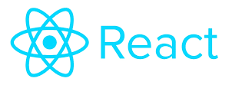
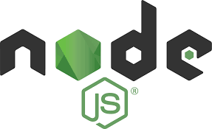




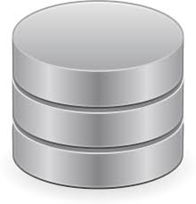
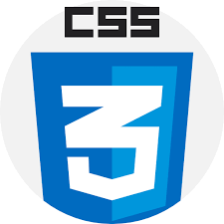
Architecture Diagram MERN Stack:
React interacts with the Express server through API calls.
Frontend framework by React. The following components are:
Cart
LoginSignup
Product
Shop
ShopCategory
Navbar
NewCollections
NewsLetter
Offers
Popular
ProductDisplay
RelatedProducts
Item
Hero
Footer
DescriptionBox
There are .jsx files and then there are the .css files with the same name for styling
HTML
Node.js is the runtime environment responsible for executing the Express.js server.
This is the server with the connection between Express and MongoDB to handle database operations.
JAVASCRIPT
Express managed API endpoints:
Defined by simple endpoint “/”.
DATABASE
LAYER
CSS

Slide 4
Overview:
Here’s an overview of the technological choices used for the front end of the e-commerce website:
Node.js and Express.js:
The backend is meticulously crafted using Node.js and Express.js, harnessing the power of these technologies to build a scalable and efficient server architecture.
Database Connection:
MongoDB is my chosen database system, seamlessly integrated to handle data storage. Leveraging the convenience of MongoDB Compass for cloud interactions, I will ensure a secure and streamlined database connection.
API Endpoints:
The backbone of my backend lies in the definition of essential API endpoints. A simple yet vital endpoint ("/") is established to verify the seamless functioning of my Express app, laying the foundation for a robust API structure.
Middleware:
Navigating the complexities of incoming JSON requests is made simple with the `express.json()` middleware. Additionally, I have employed the `cors` middleware, enabling Cross-Origin Resource Sharing, ensuring seamless communication between my frontend and backend components.
JWT (JSON Web Tokens):
Security is paramount, and for authentication purposes, I have employed the `jsonwebtoken` library. This sophisticated tool allows me to generate and verify JSON Web Tokens, fortifying my backend against unauthorised access.
File Upload Handling:
The need for efficient file uploads is met with the implementation of the `multer` middleware. Its capabilities streamline the handling of file uploads, enhancing the overall functionality of my backend.
Server Configuration:
My server is tuned to listen on port 4000, providing a stable and accessible gateway for communication between my frontend and backend components.
Package Dependencies:
Delving into my `package.json`, the `dependencies` section meticulously lists the packages essential for the backend's seamless operation. Among these, the prominent players include Express.js, Mongoose, JSON Web Token (jsonwebtoken), CORS, and Multer, each contributing to the robustness of our backend infrastructure.
In conclusion, my backend is not just a technological backbone; it's a carefully orchestrated symphony of technologies and methodologies designed to propel our application to new heights of efficiency, security, and scalability. As I continue to embark on this journey, the backend stands ready, a steadfast foundation supporting the innovation and functionality that define my application's success.

Slide 5
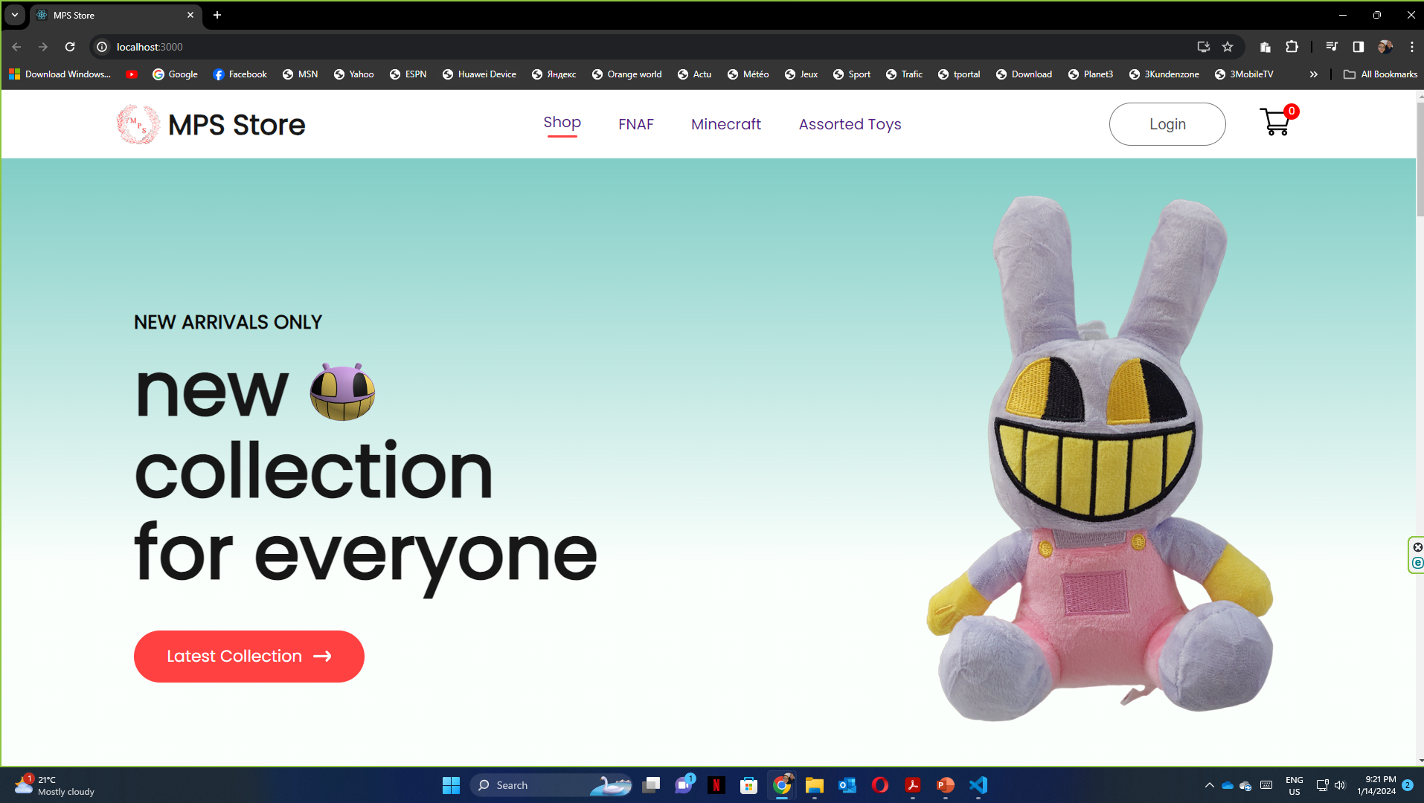
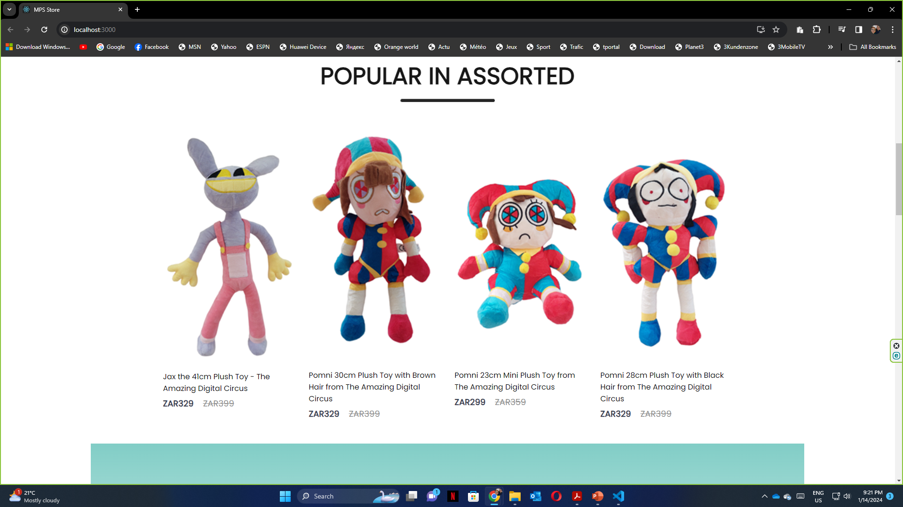
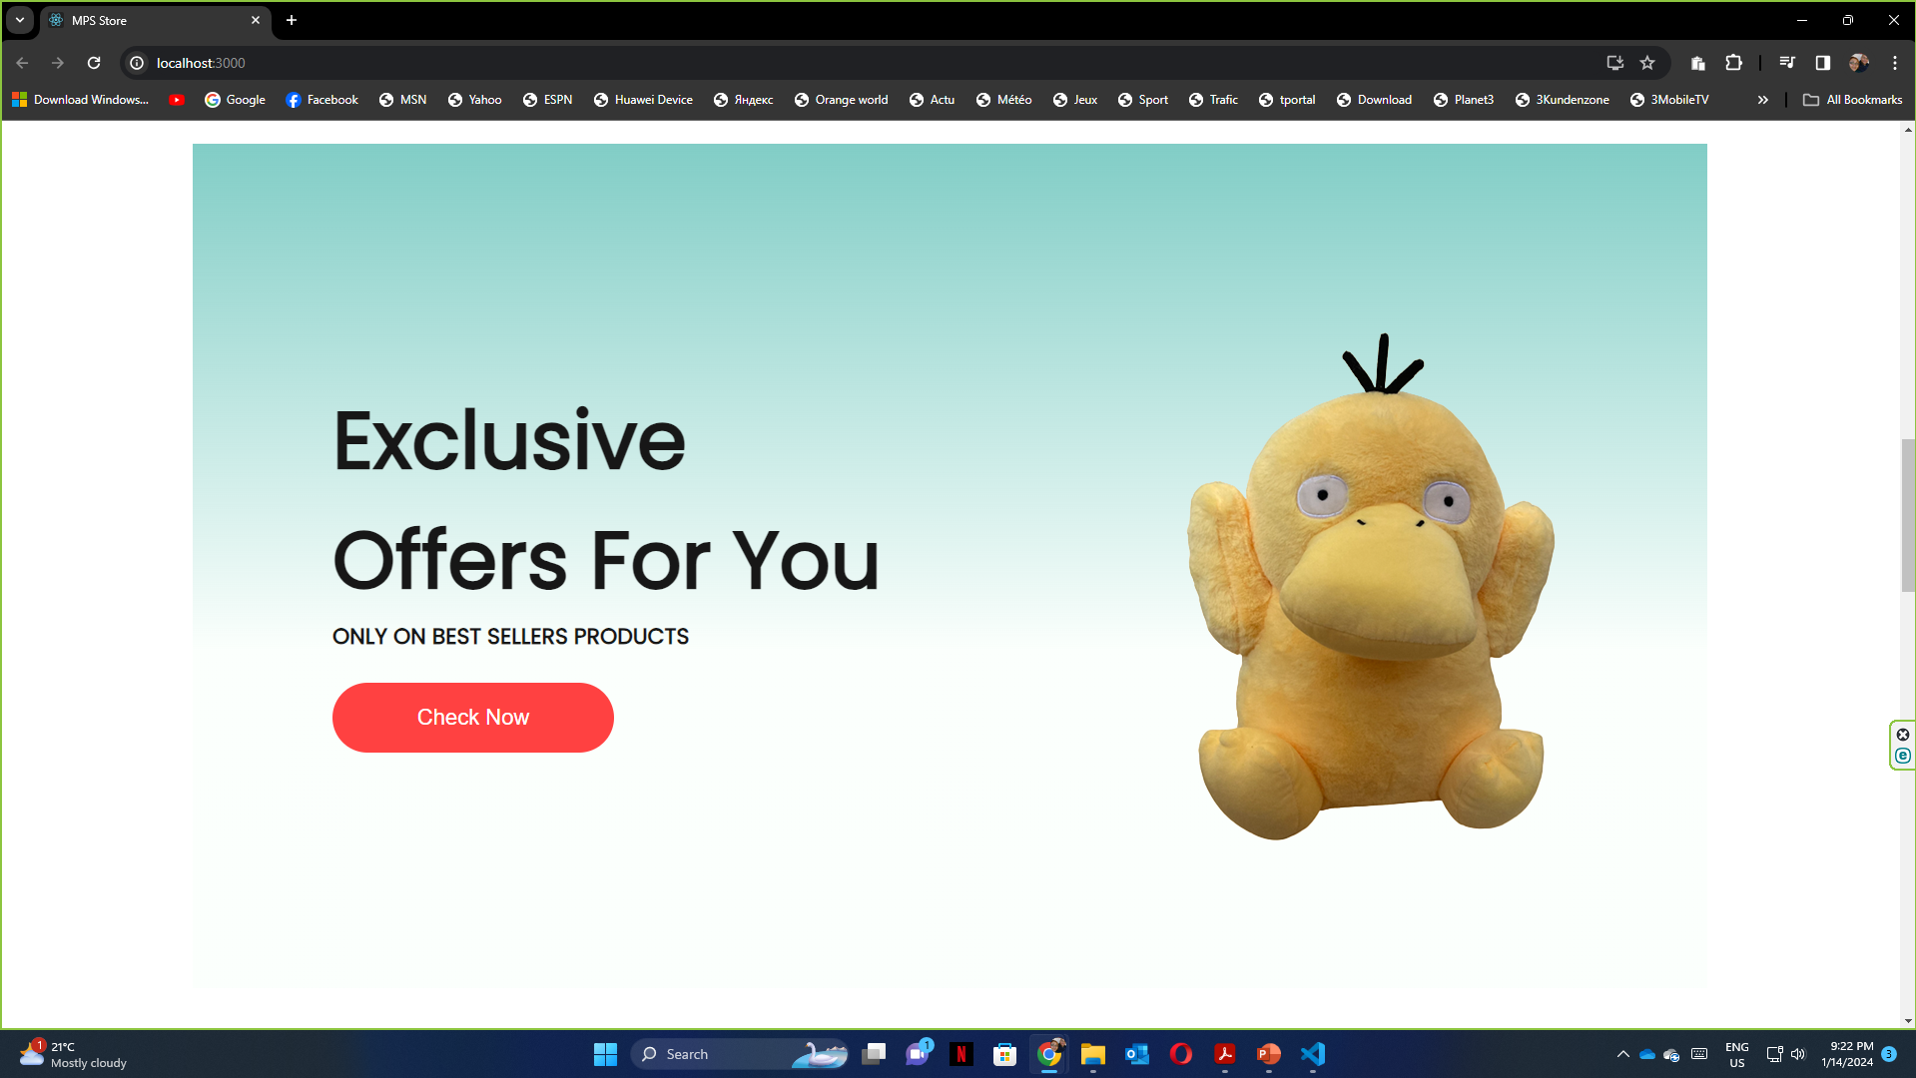
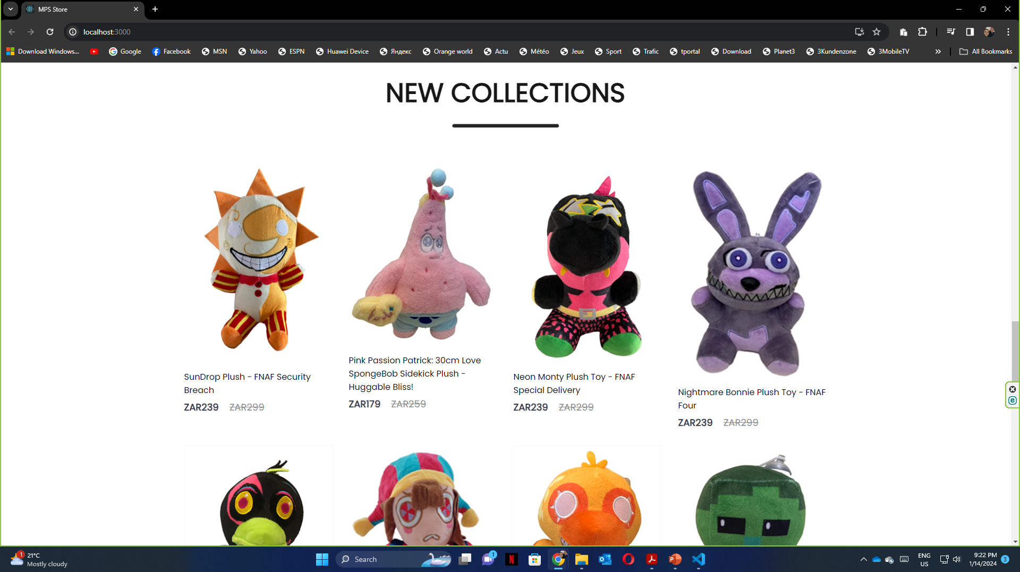
Screenshots:

Slide 6
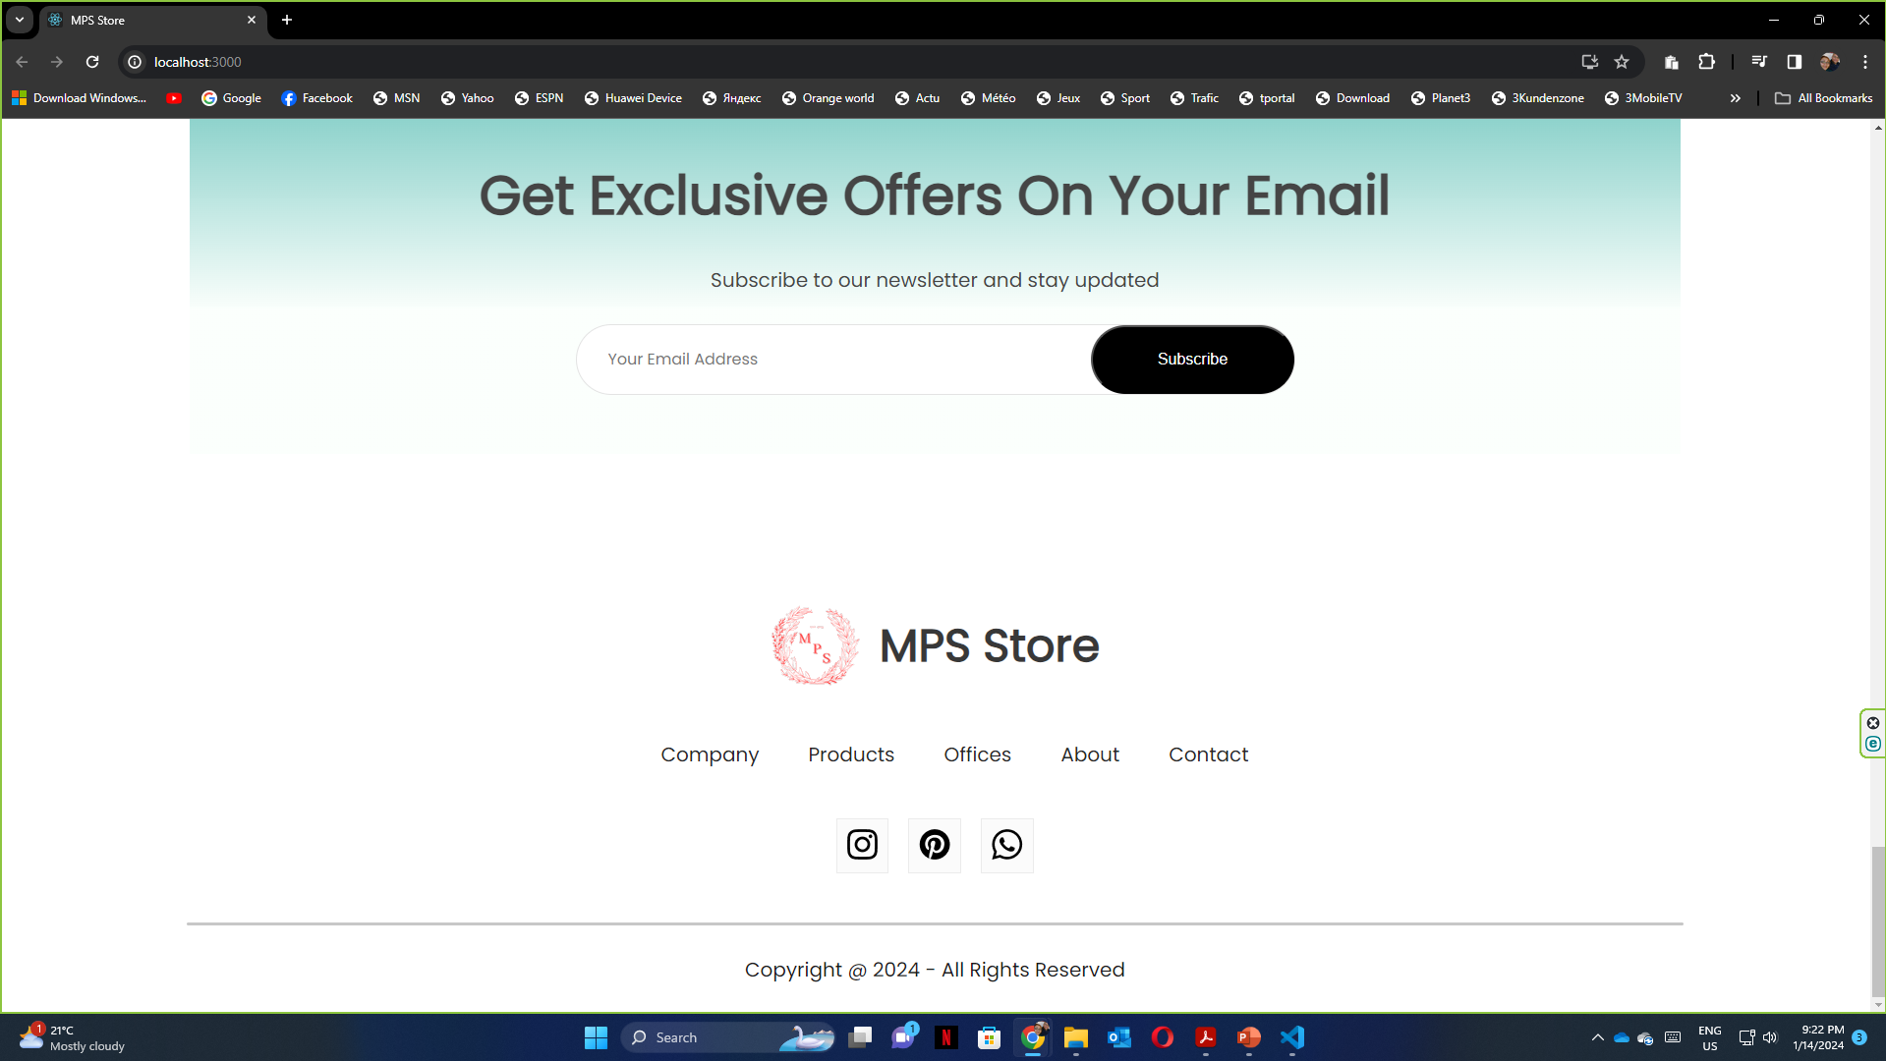
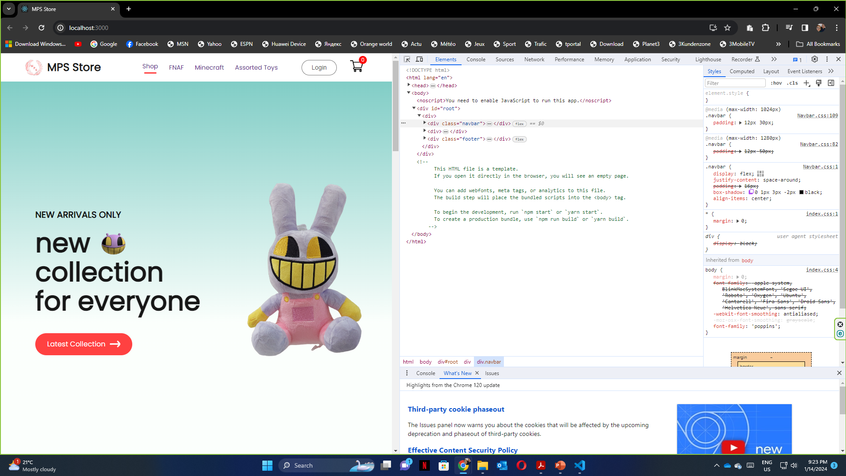
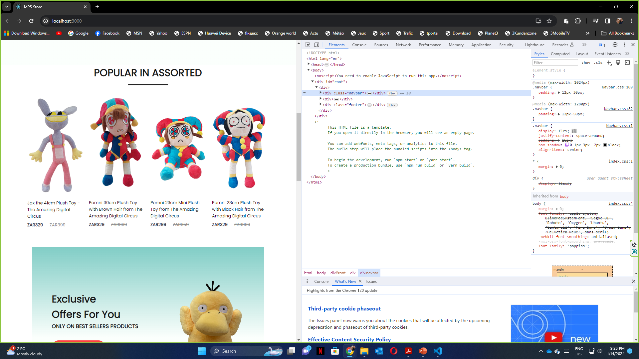
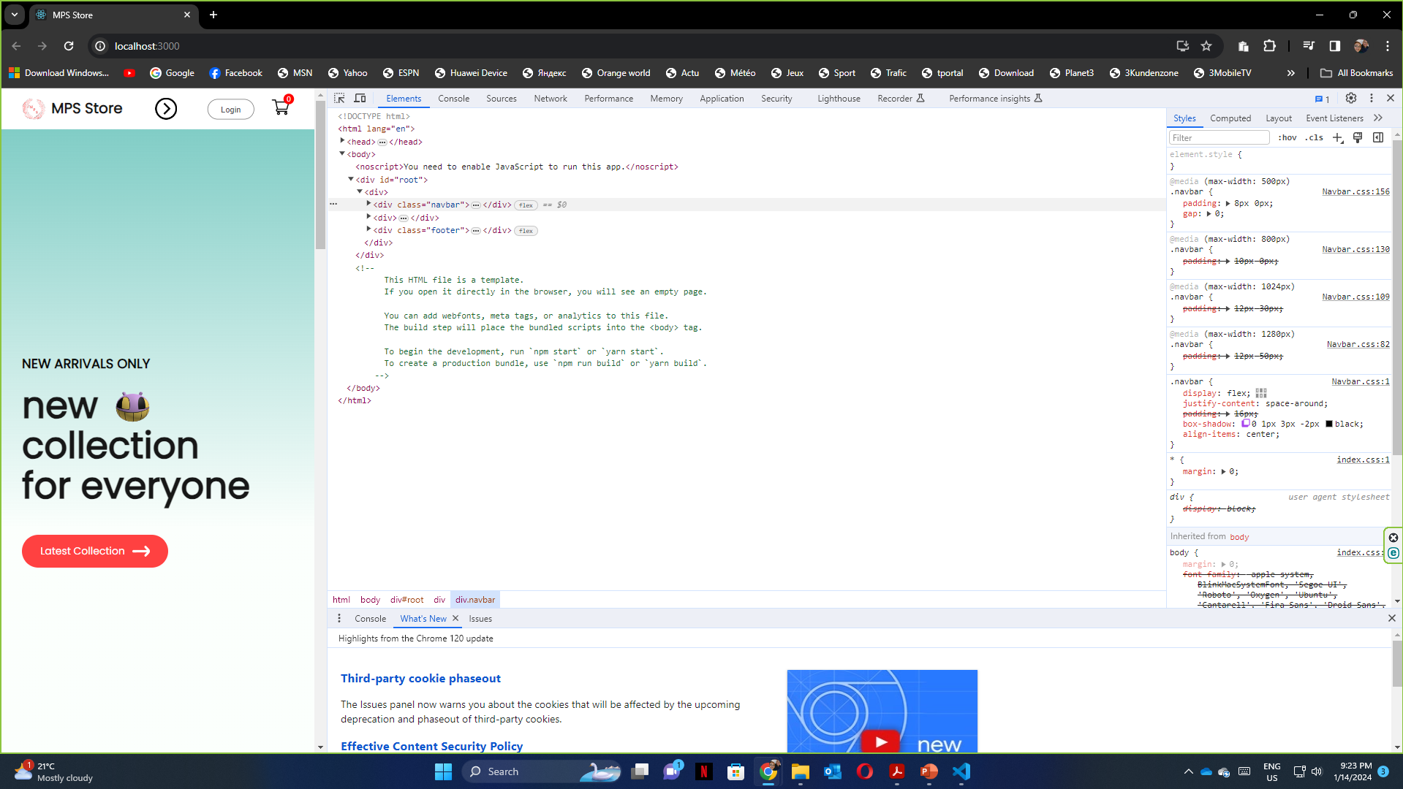
Screenshots:

Slide 7
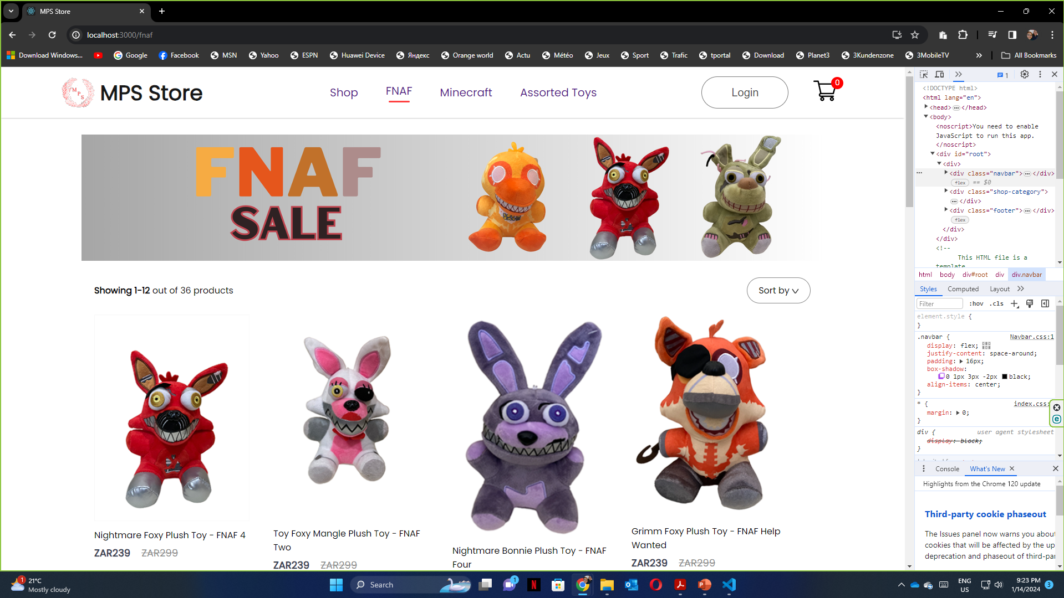
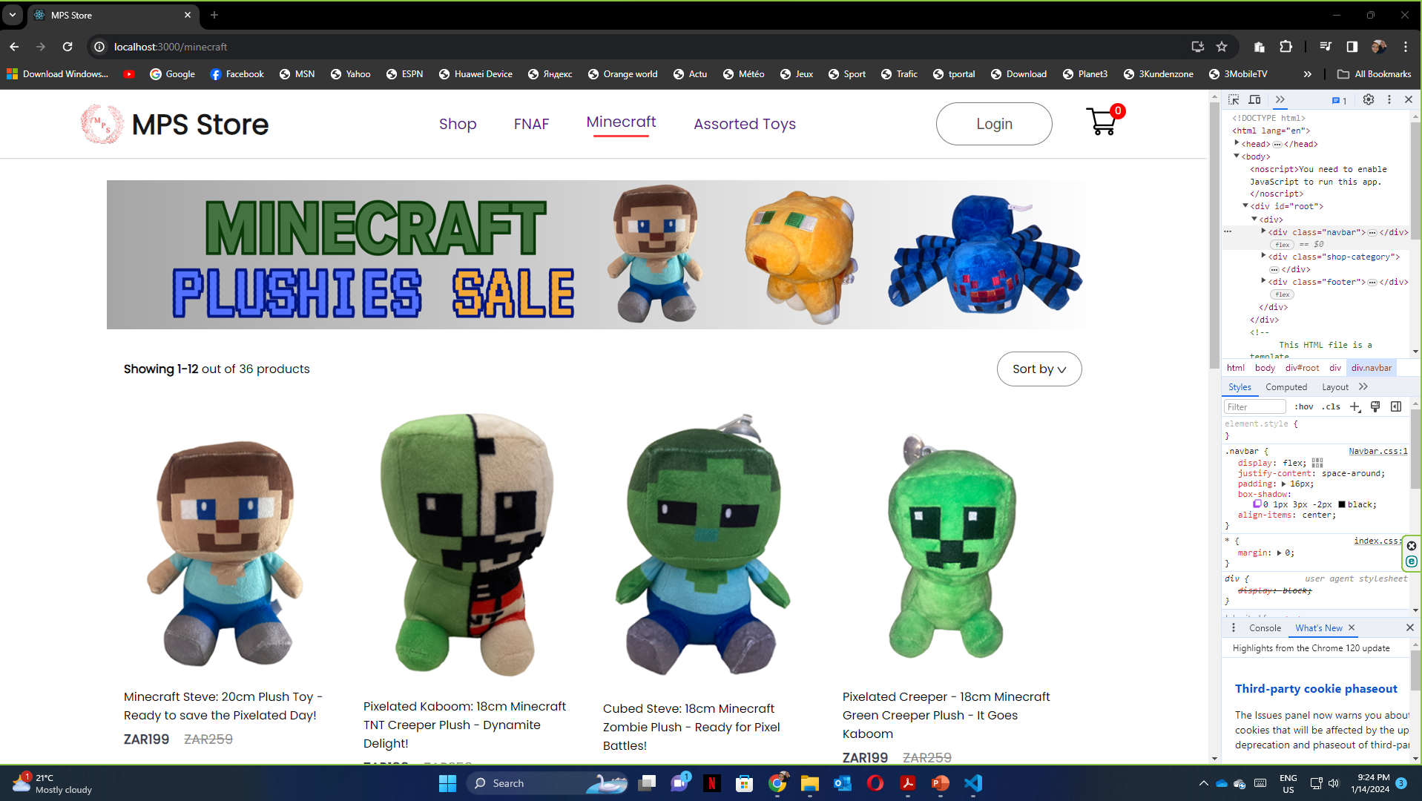
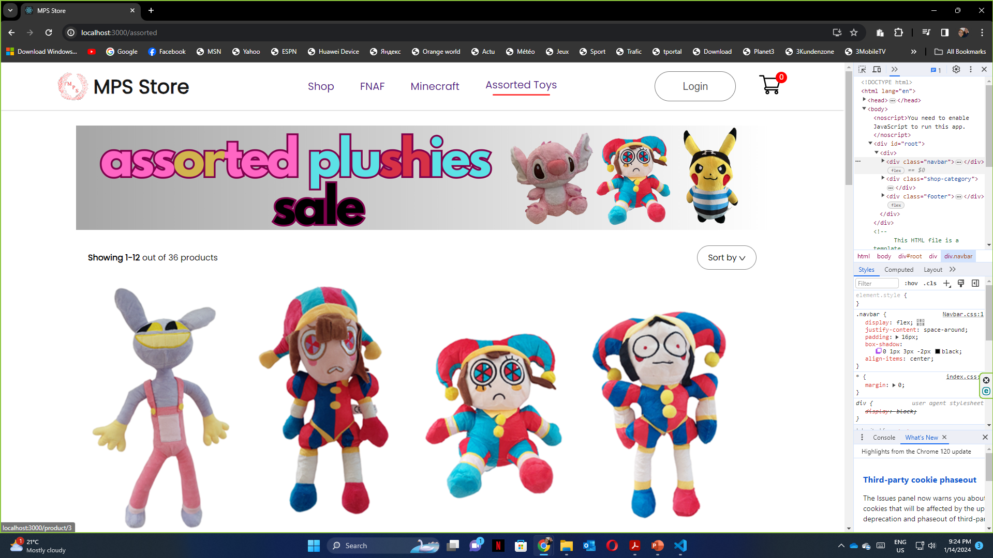
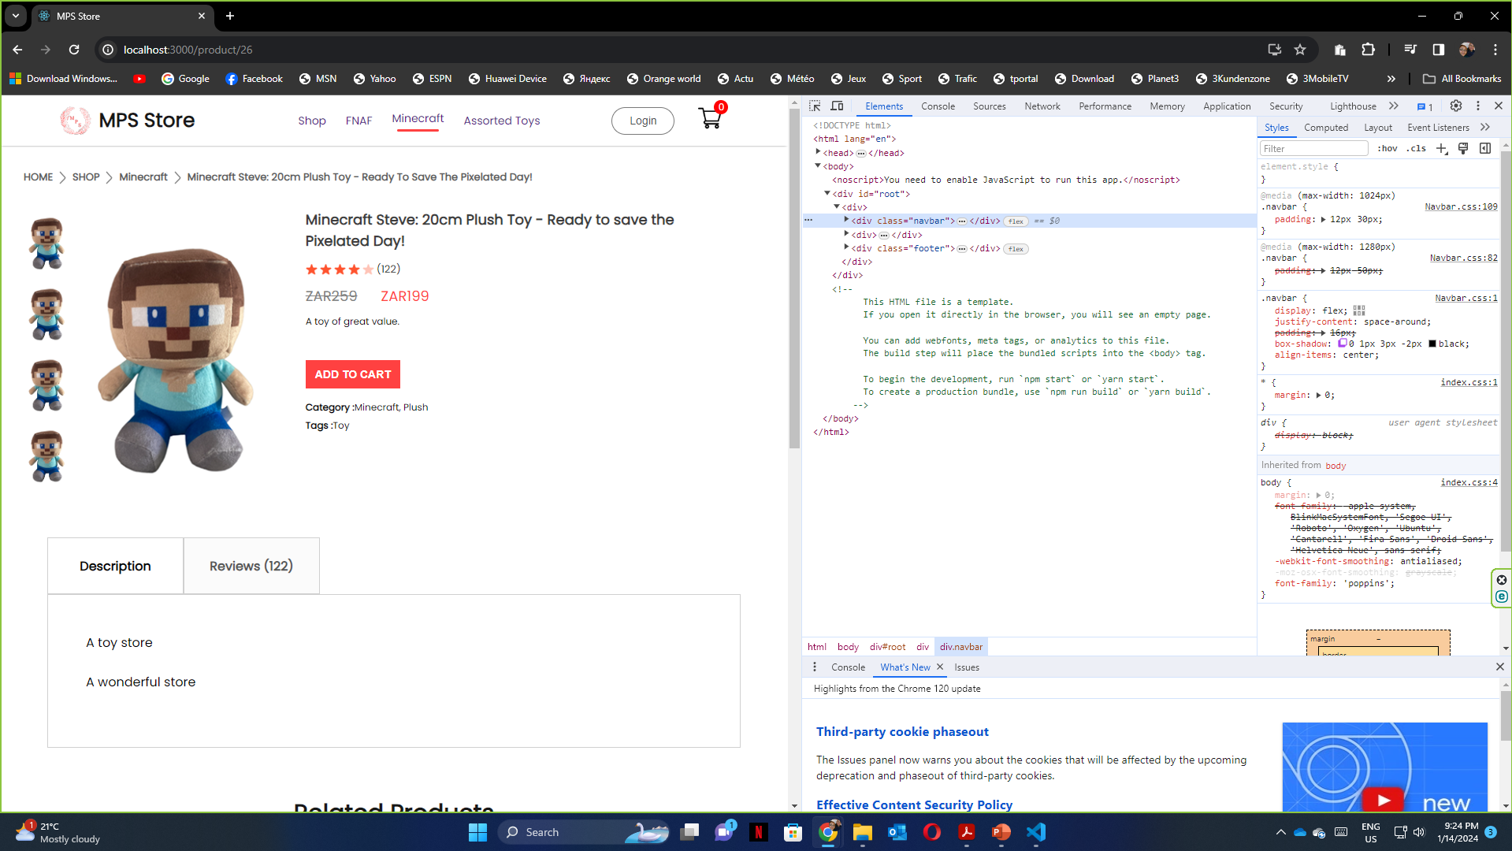
Screenshots:

Slide 8
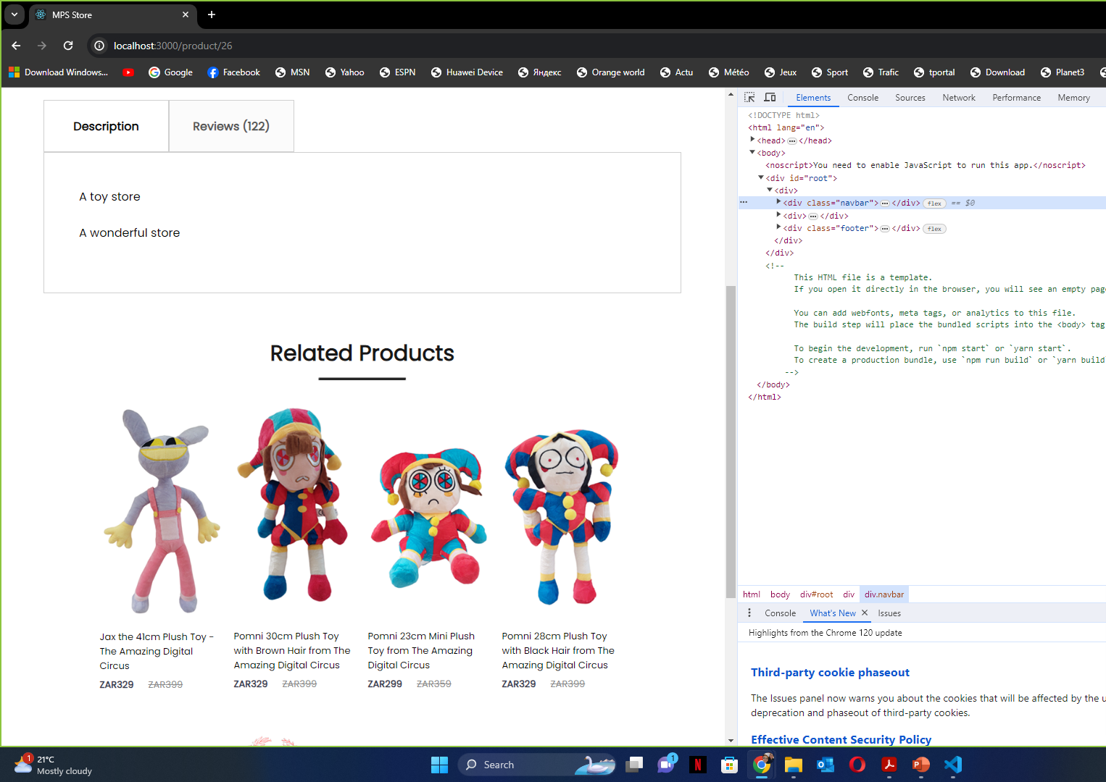
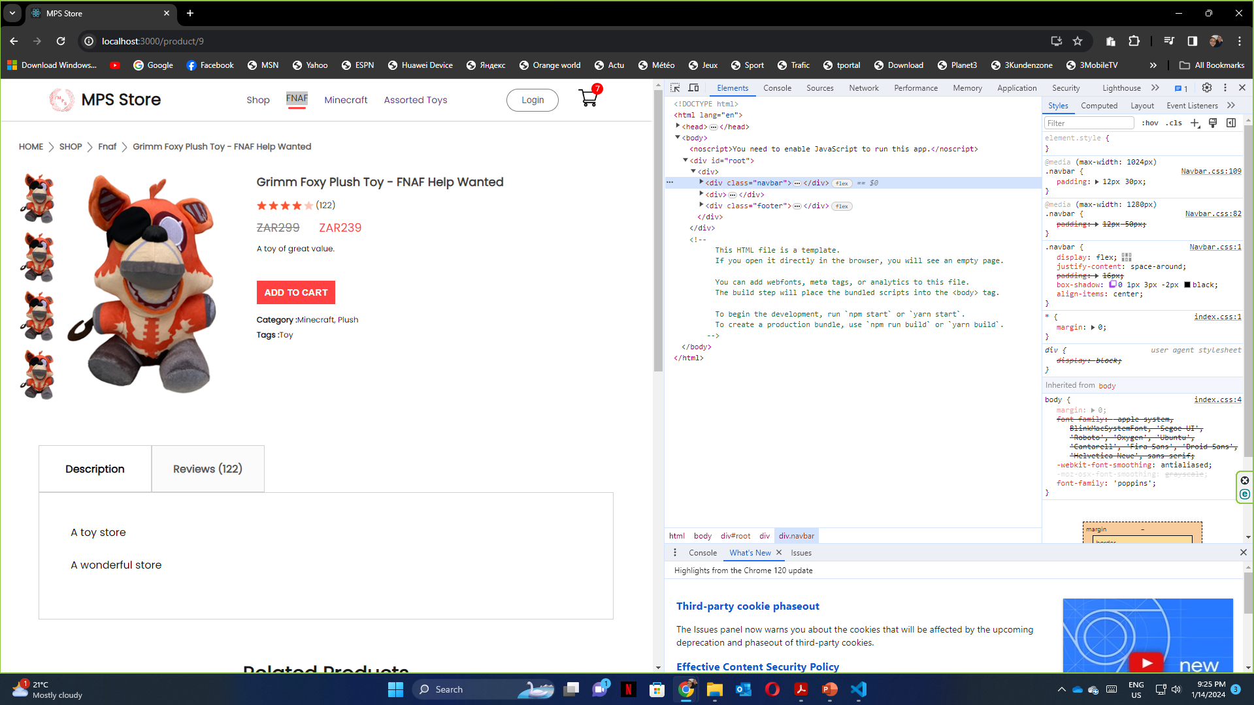
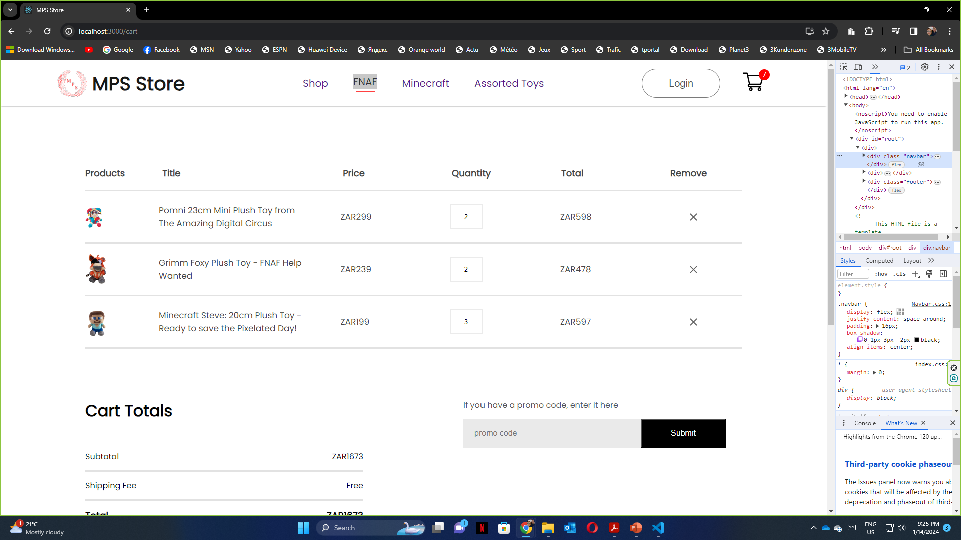
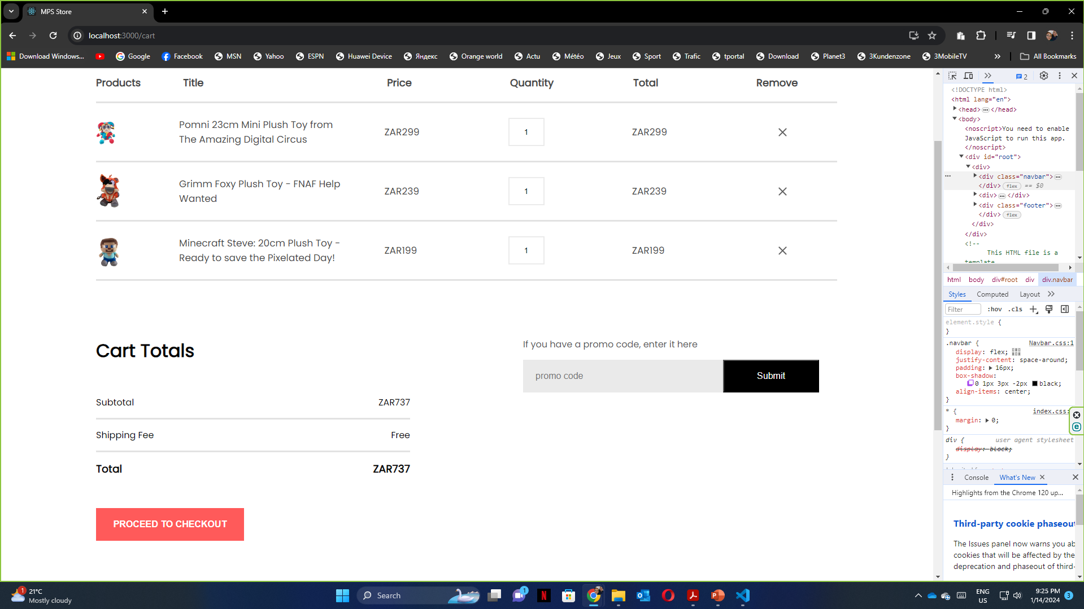
Screenshots:

Slide 9
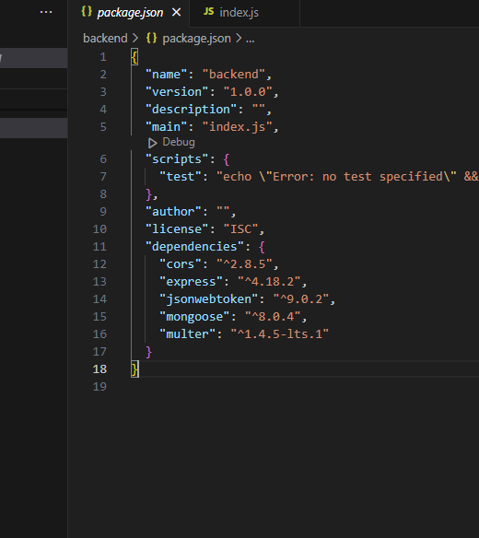
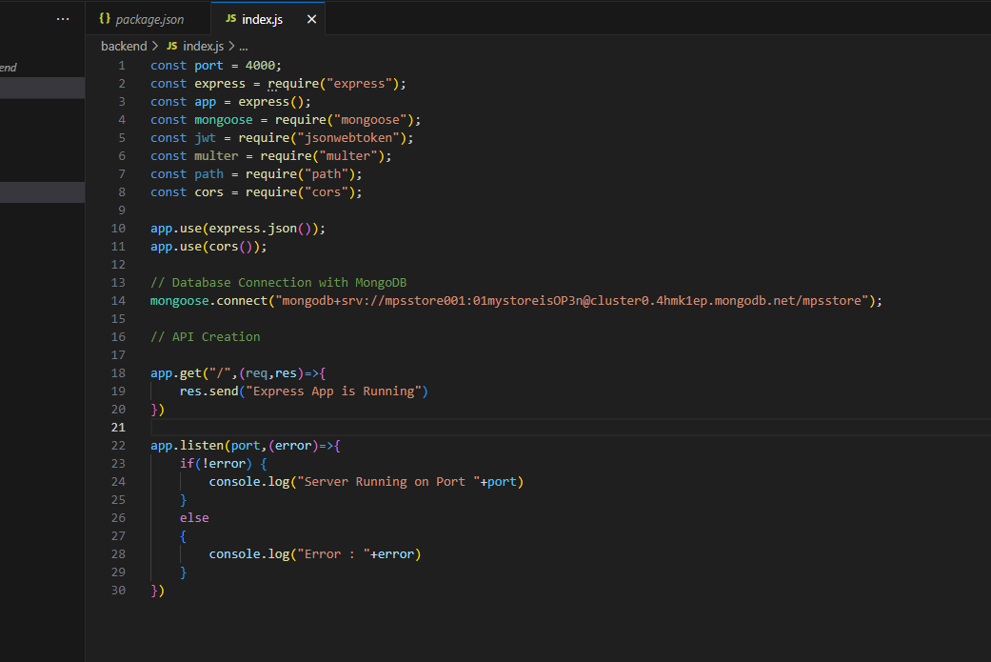
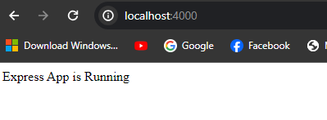
Screenshots:

Slide 10
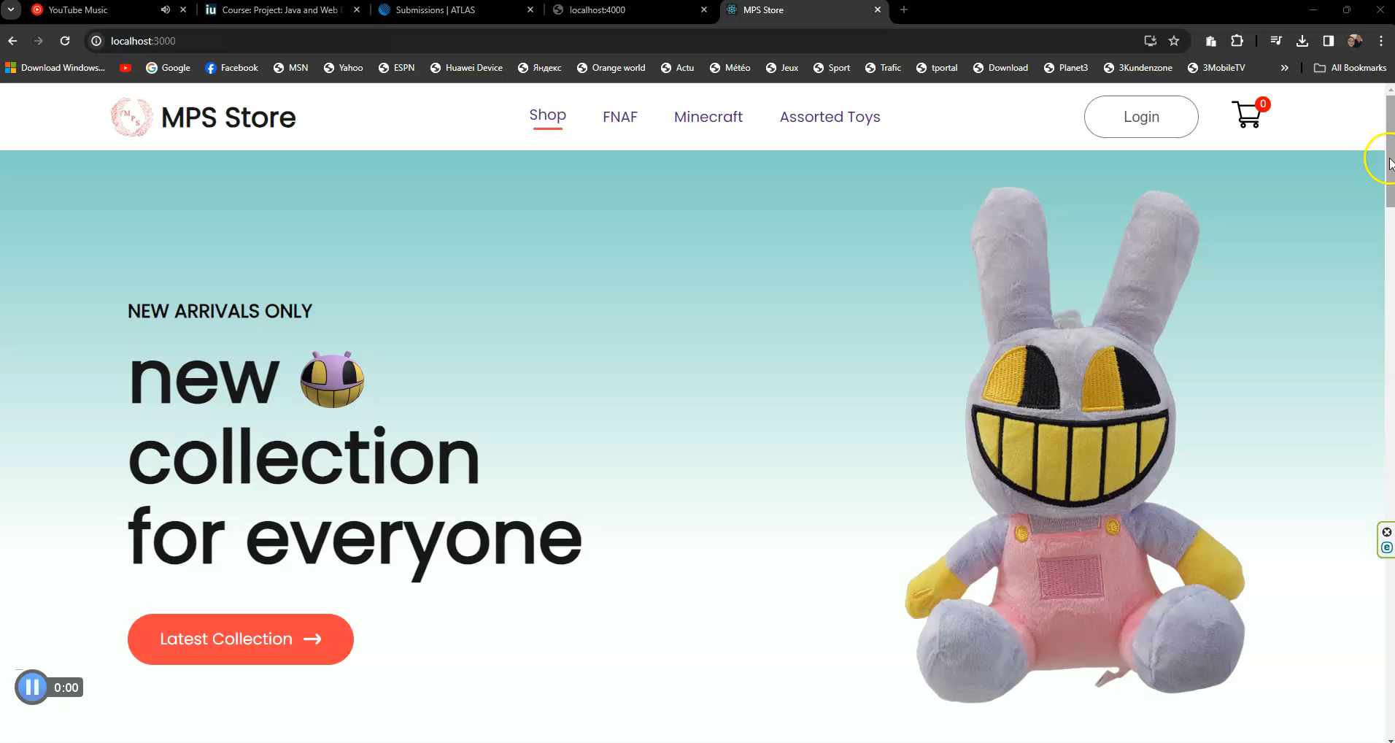
Screencast:

